Slide 1
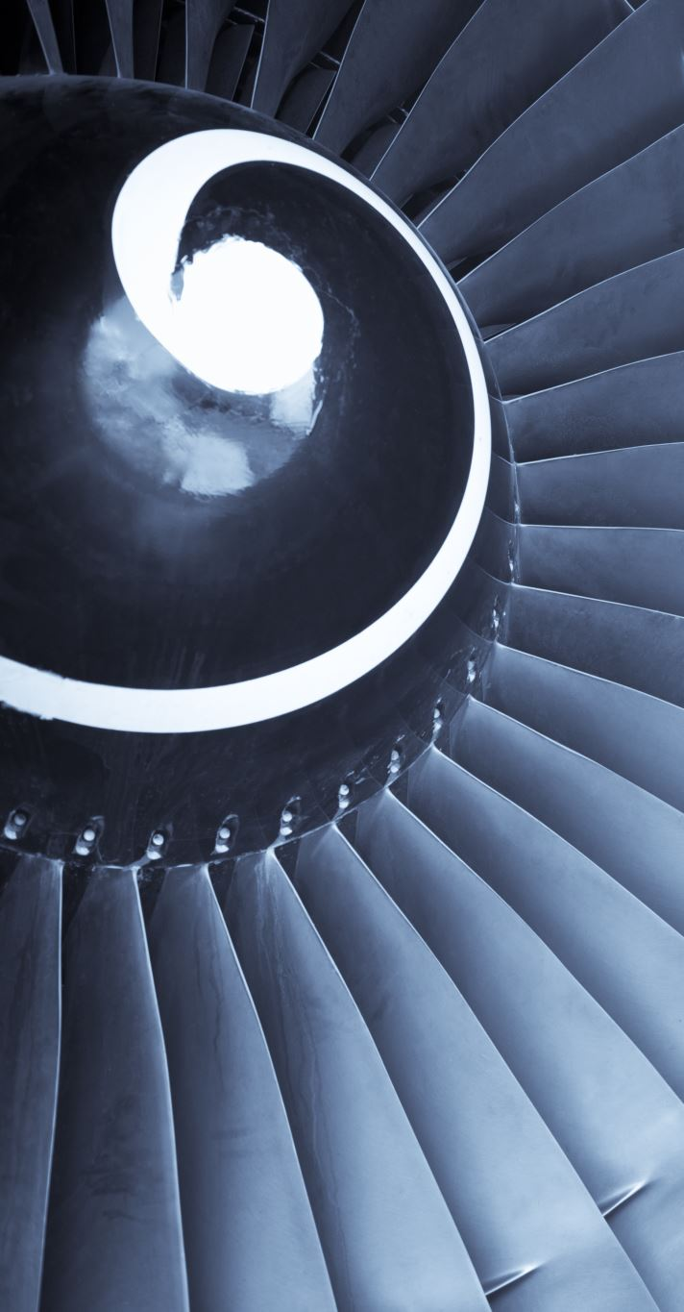
Aircraft Fuselage Defect Detection Using CNN
By: Adam O’Connor and Jake Whited
ECEN 5060

Slide 2
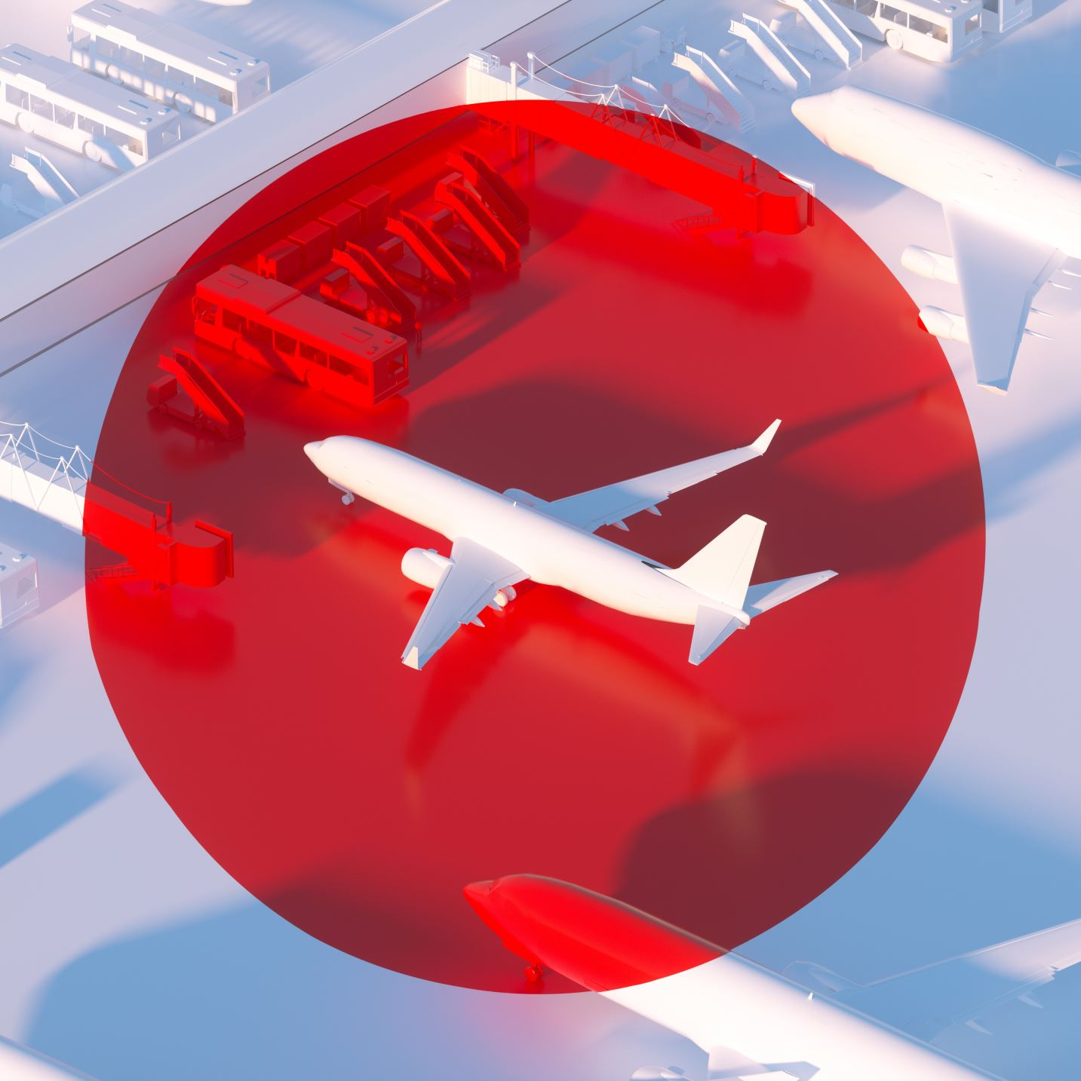
Project Overview
Goal: Detect defects on aircraft fuselage surfaces.
Strategy: Train CNN on limited labeled data.
Expand dataset through pseudo-labeling.

Slide 3
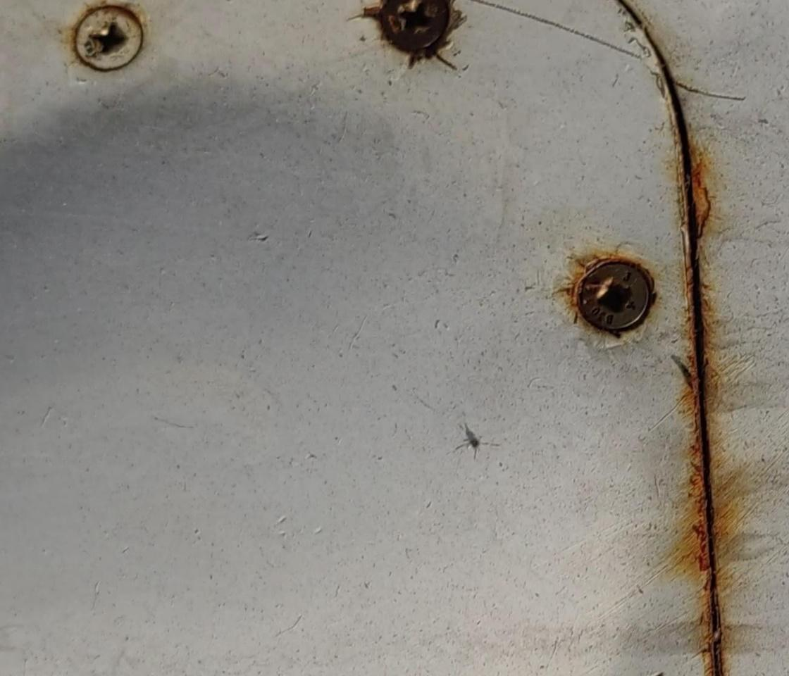
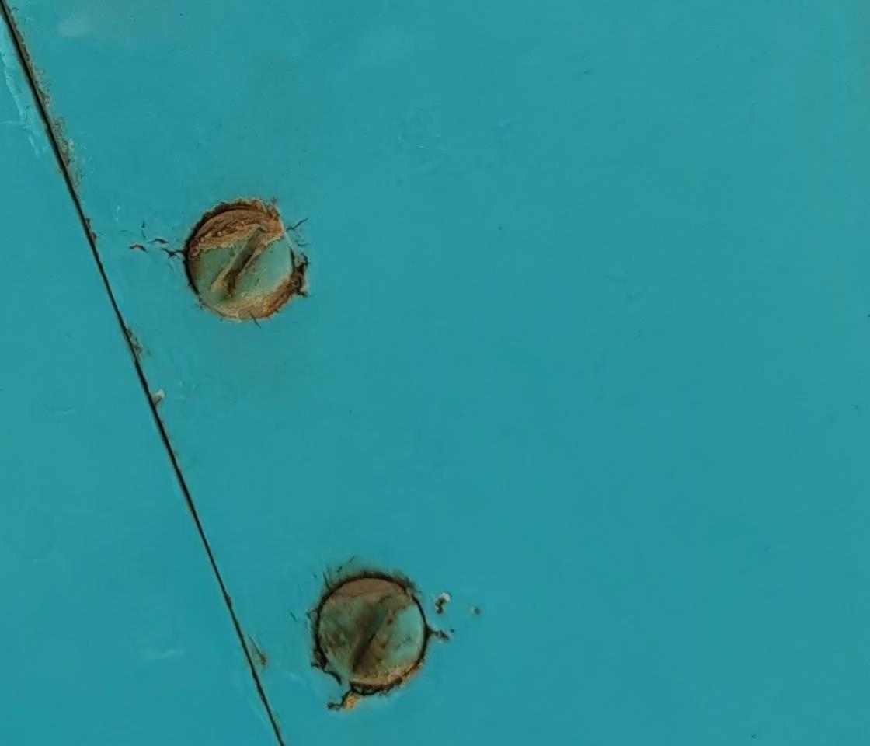
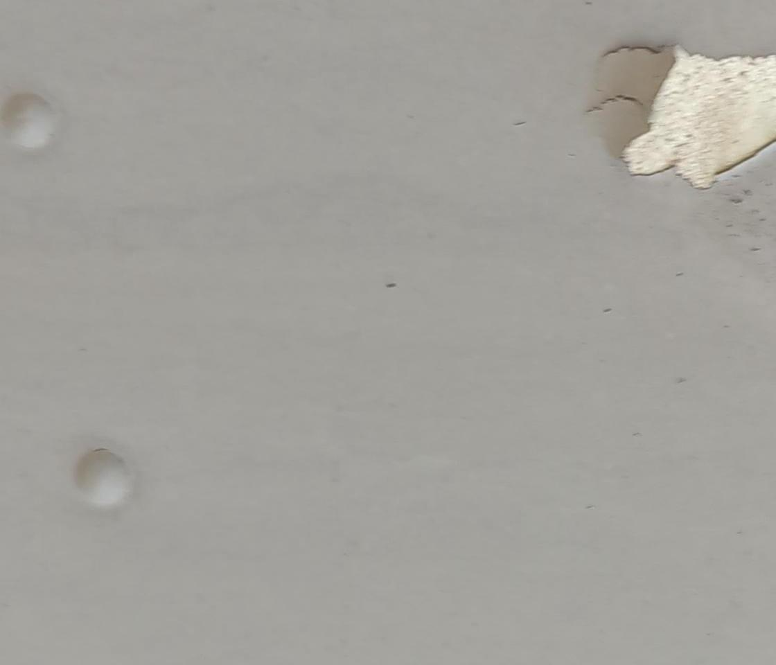
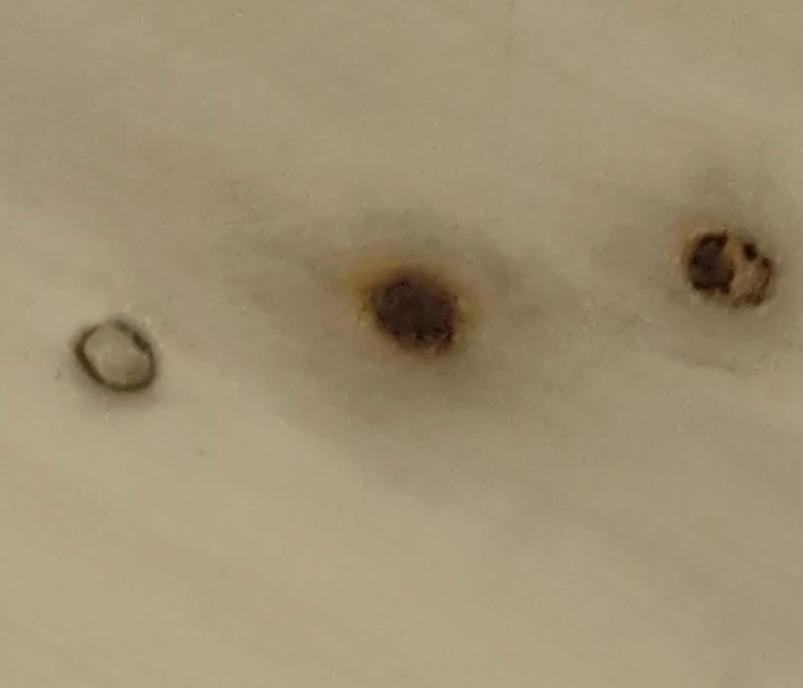
Dataset
5601 images total
389 labeled images, 5212 unlabeled
4 defect classes: Scratch, Paint Peel, Rivet Damage, Rust
High resolution: 1120 × 960 pixels
x,y image coordinates of each defect

Slide 4
Data Preprocessing
Resize images to 250 × 250 pixels.
Labels extracted from COCO JSON annotations.
Multi-label binarization for multi-defect cases.
Augmentation: rotations, flips, color jitter.

Slide 5
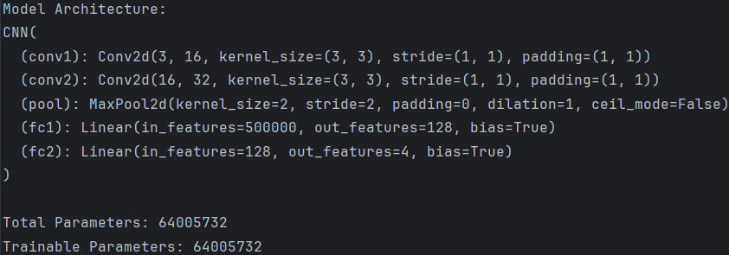
Model Architecture
Simple CNN:
2 convolutional layers
Max pooling, ReLU activations
2 fully connected layers
Output: 4 defect probabilities (sigmoid)

Slide 6
Training Setup
Optimizer: Adam
Loss: Binary Cross-Entropy
Batch Size: 30
Learning Rate: 0.001
Device: GPU if available

Slide 7
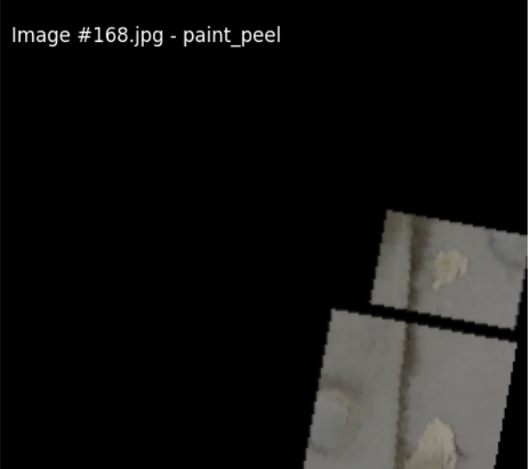
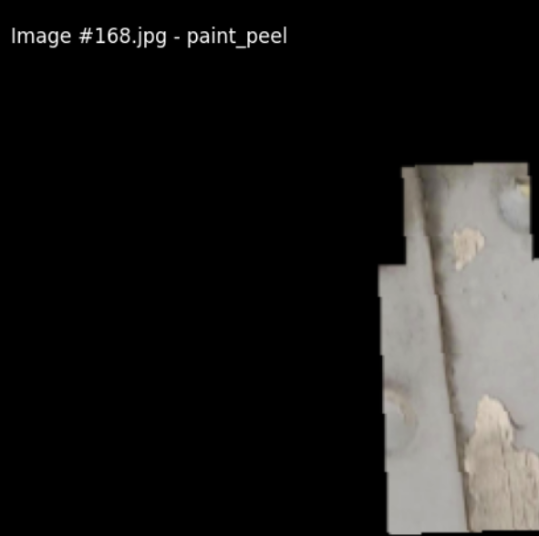
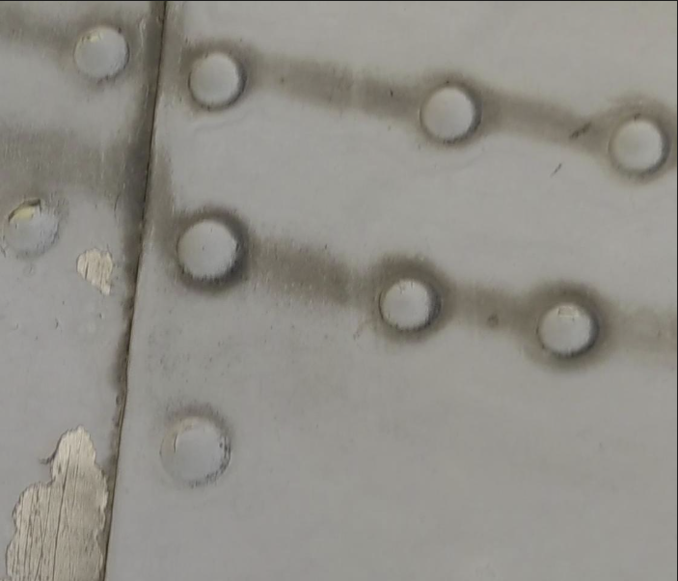
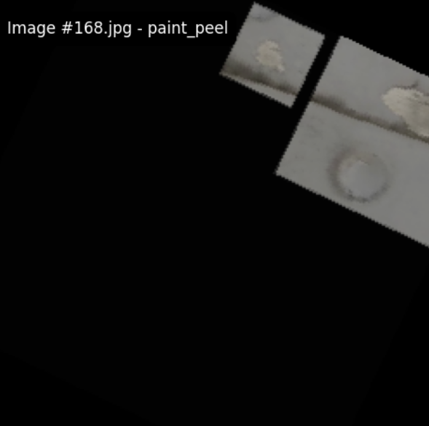
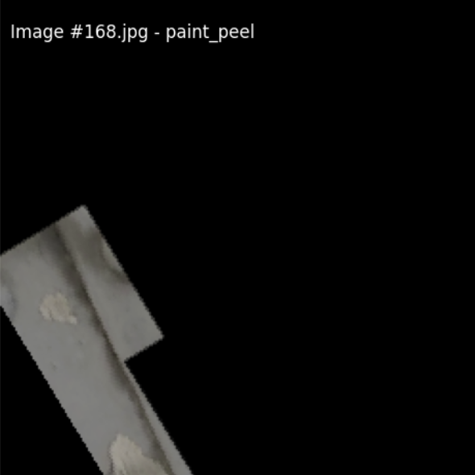
Paint Peel
Original Image

Slide 8
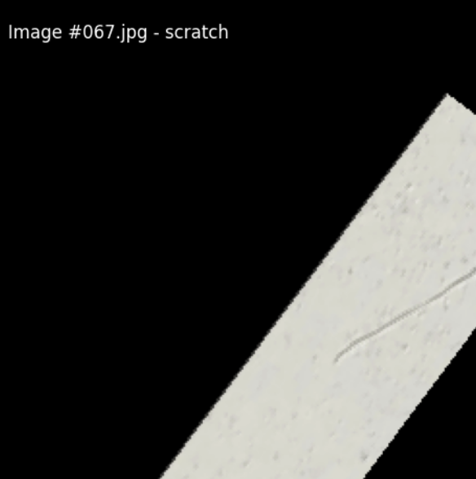
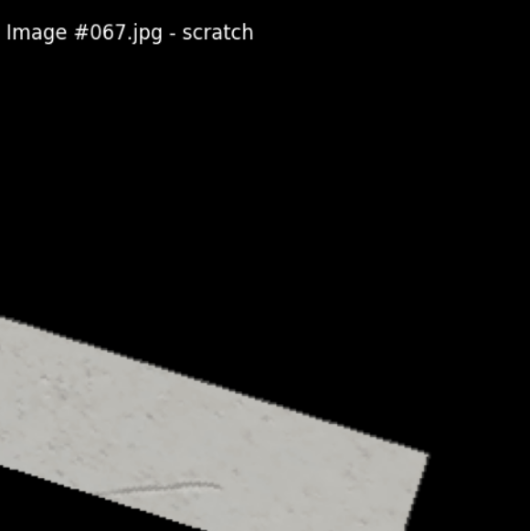
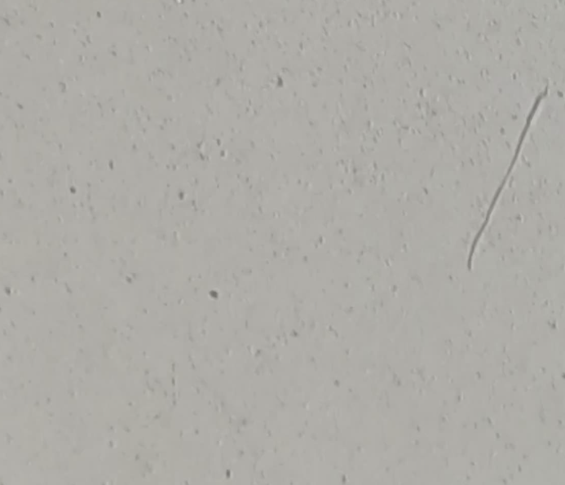
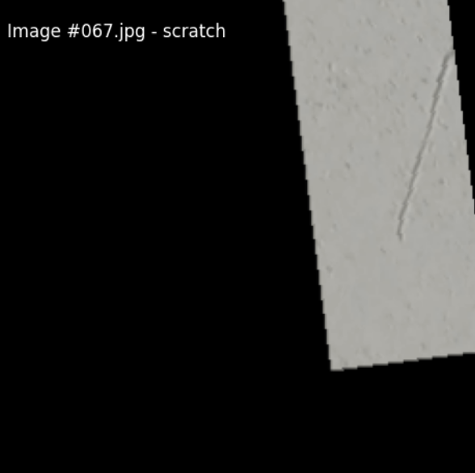
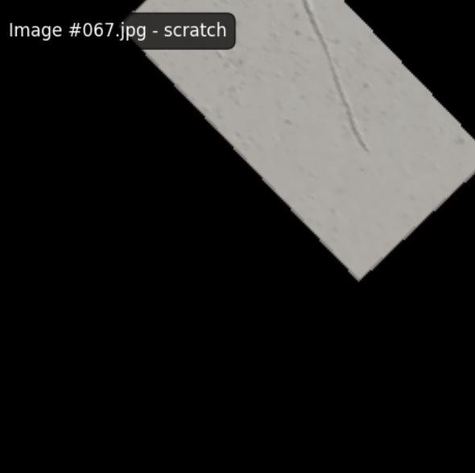
Scratch

Slide 9
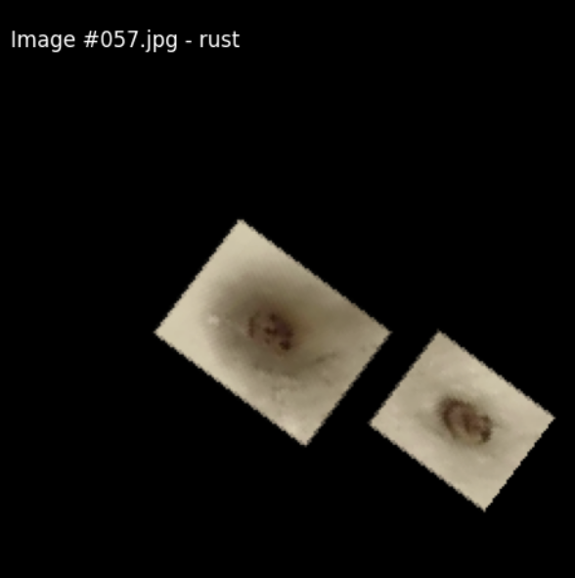
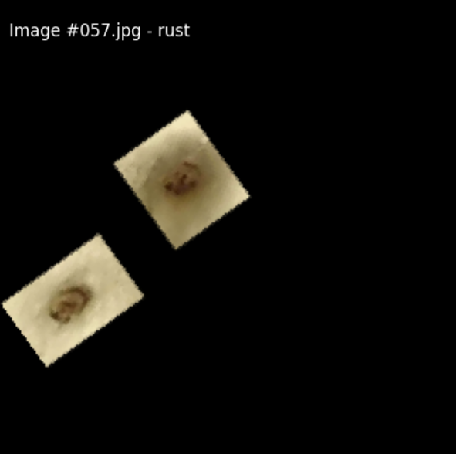
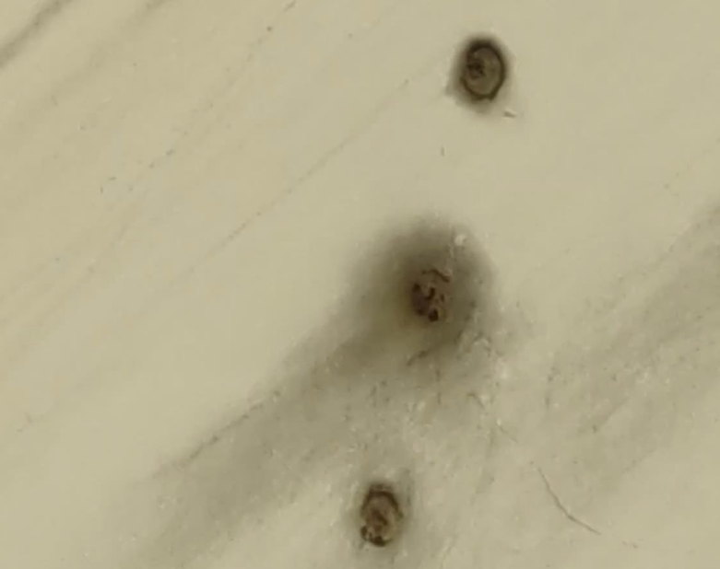
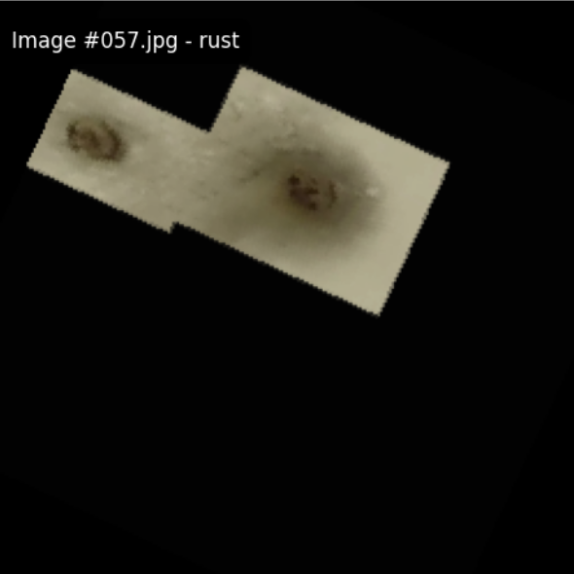
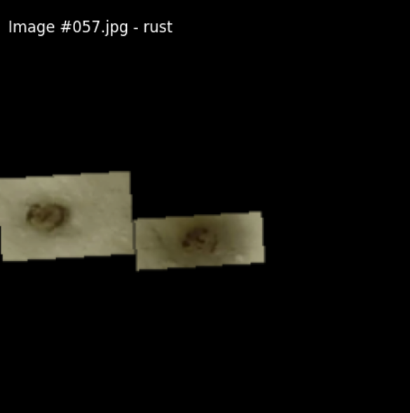
Rust
Original Image

Slide 10
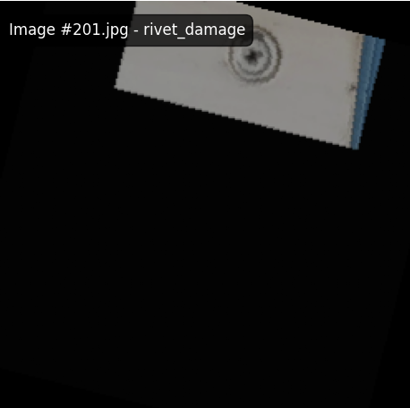
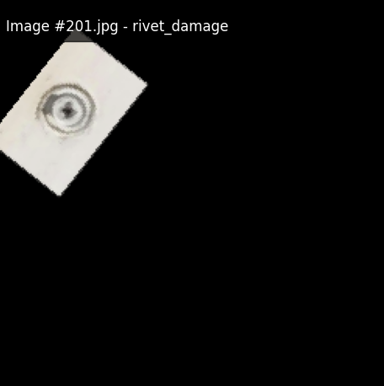
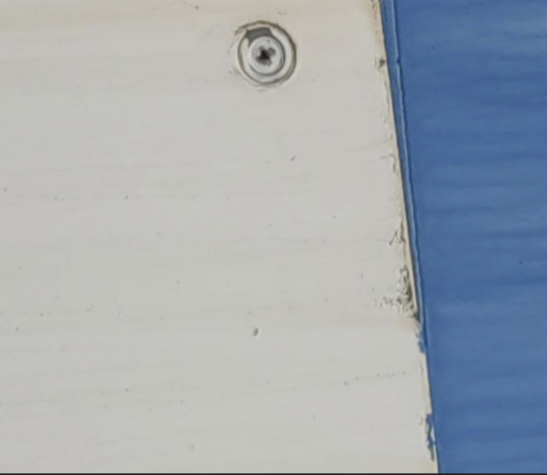
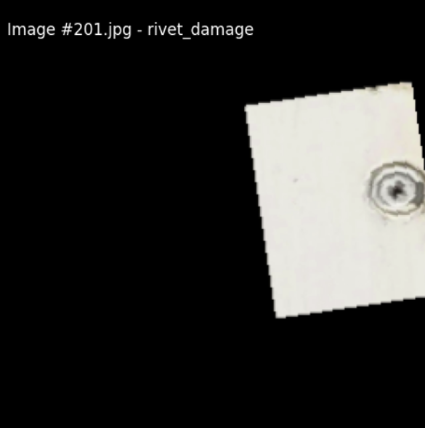
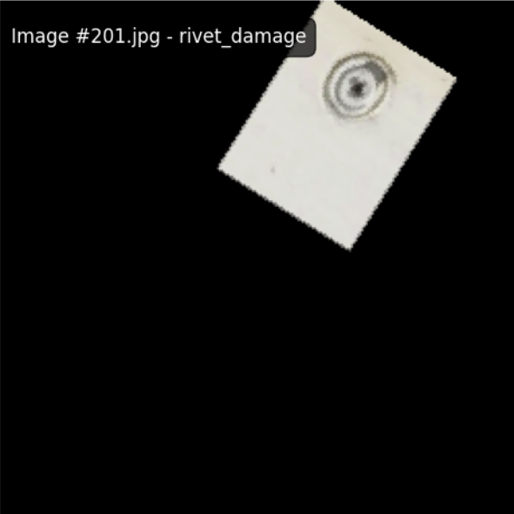
Rivet Damage

Slide 11
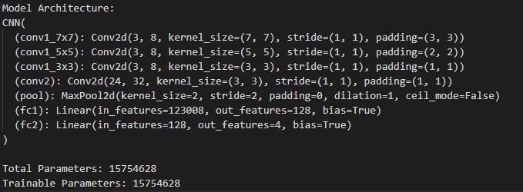
Final Model Architecture
Best CNN:
3 parallel convolutional layers in the first layer
3 layers concatenated together
Max pooling, ReLU activations
2 fully connected layers
Output: 4 defect probabilities (sigmoid)

Slide 12
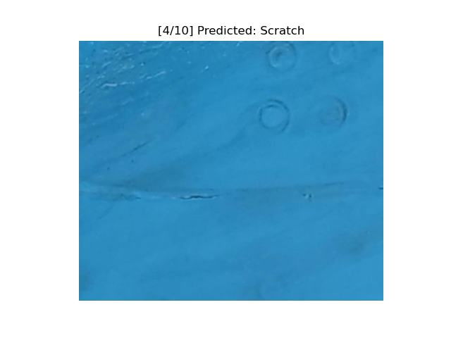
Pseudo-Labeling Unlabeled Data
Model predicts labels on 5212 images.
Threshold: probability > 0.4 = label assigned.
Results saved to CSV.
Created a larger labeled dataset.

Slide 13
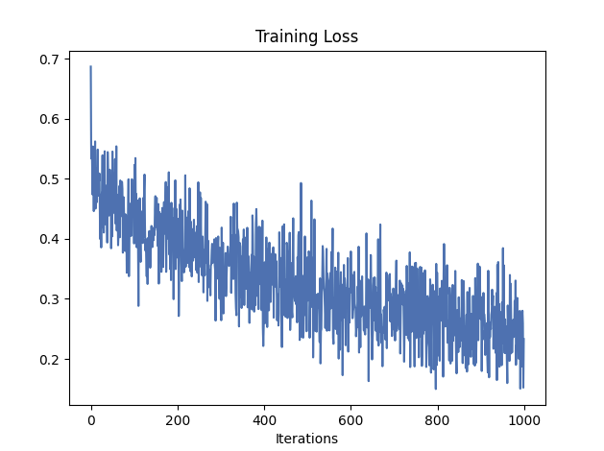
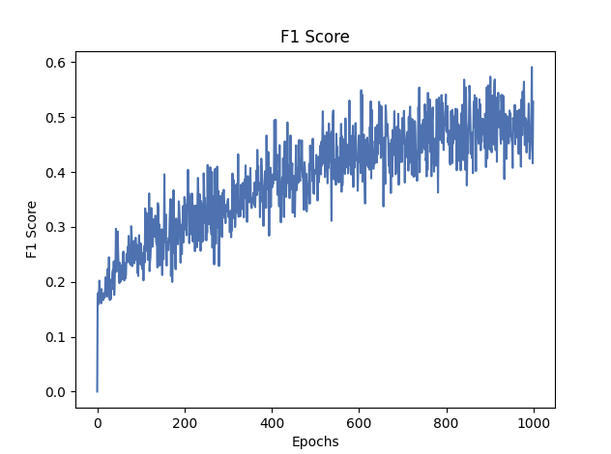
Key Outcomes
Built a working multi-label classifier.
Pseudo-labeled entire unlabeled dataset.
Set up for future semi-supervised learning.
Ready to move toward object detection.

Slide 14
Classification Report
 | precision | recall | f1-score | support
paint_peel | 1.00 | 0.10 | 0.18 | 20
rivet_damage | 0.50 | 0.71 | 0.59 | 7
rust | 0.50 | 0.14 | 0.22 | 14
scratch | 0.66 | 0.89 | 0.76 | 37
micro avg | 0.64 | 0.54 | 0.58 | 78
macro avg | 0.67 | 0.46 | 0.44 | 78
weighted avg | 0.70 | 0.54 | 0.50 | 78
samples avg | 0.54 | 0.54 | 0.54 | 78

Slide 15
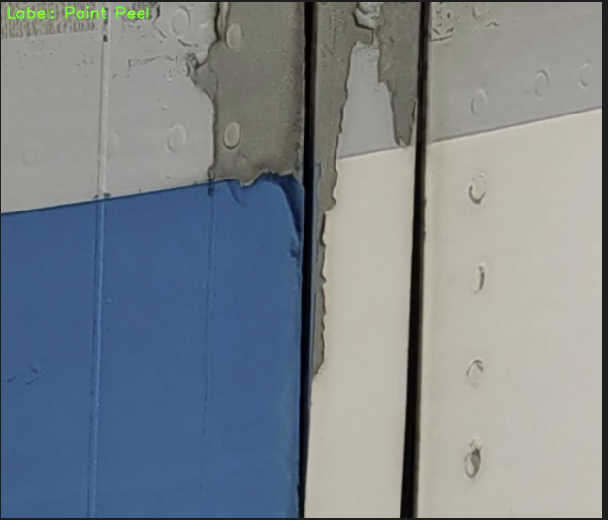
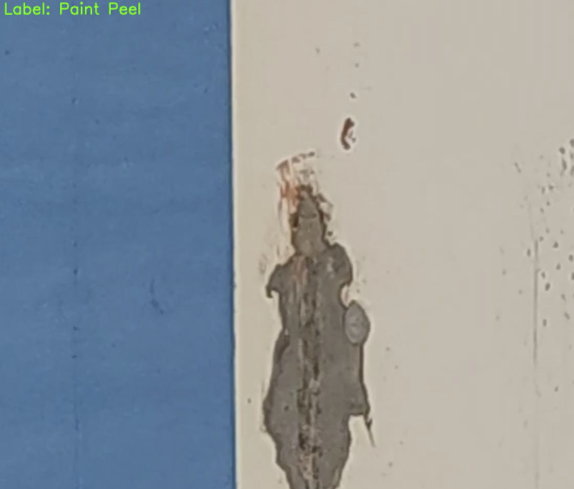
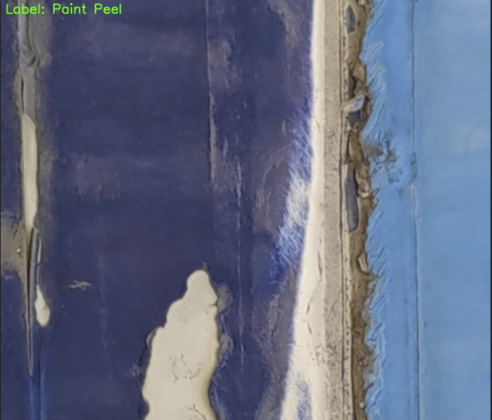
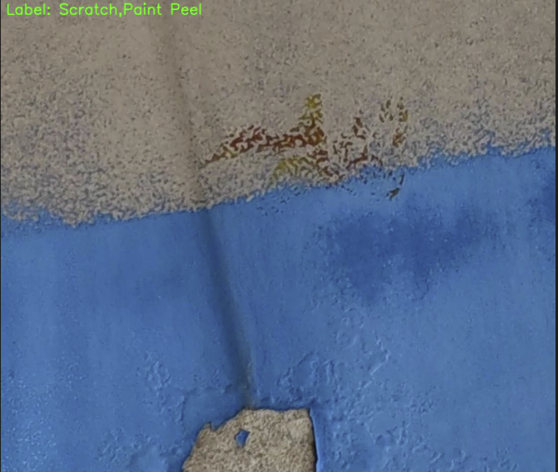
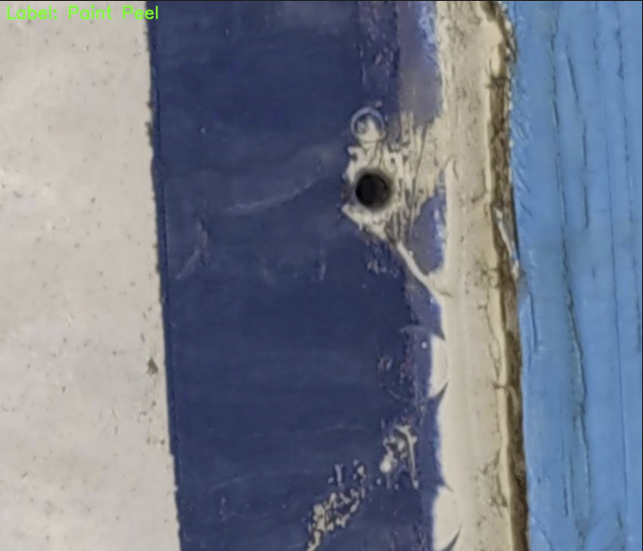
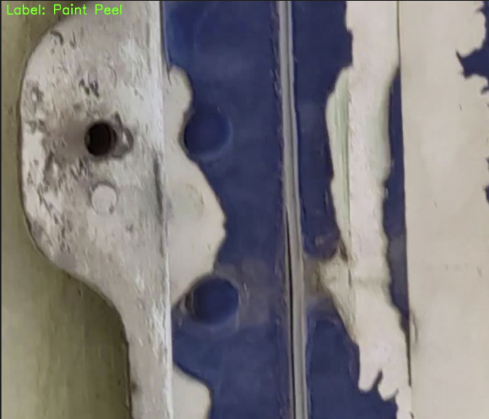

Slide 16
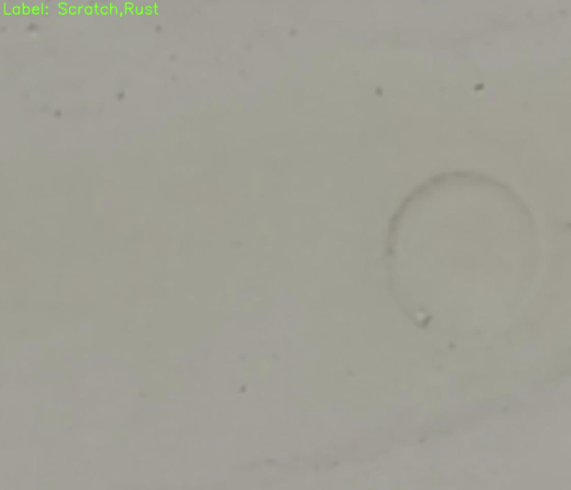
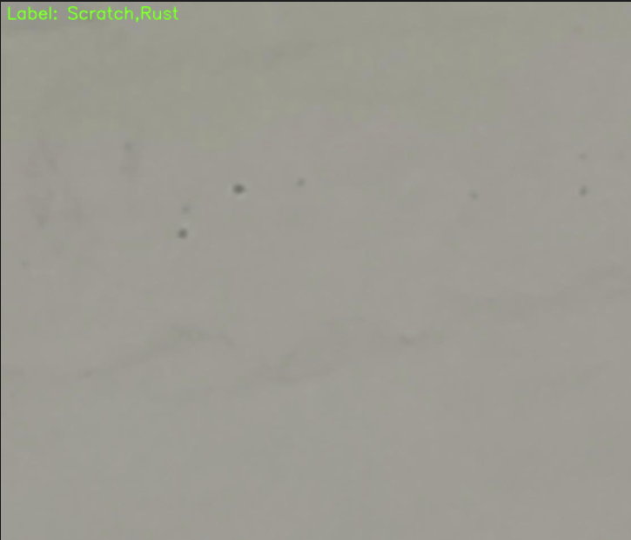
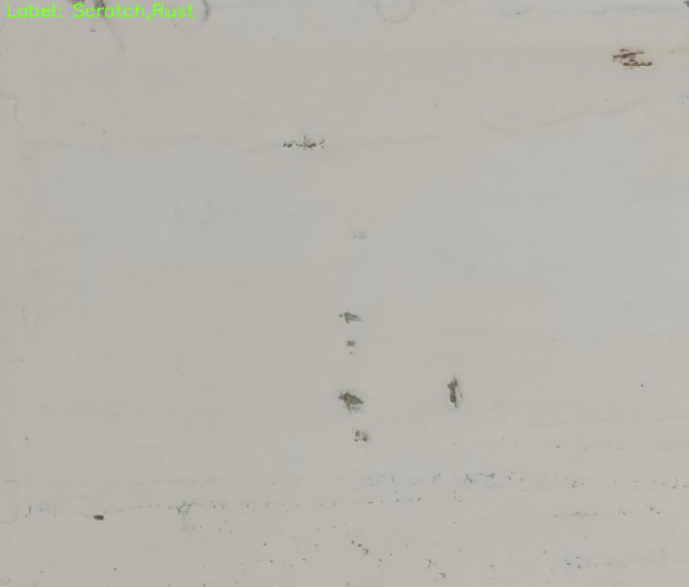
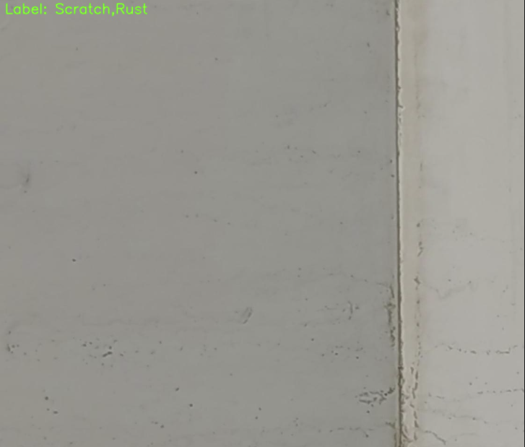
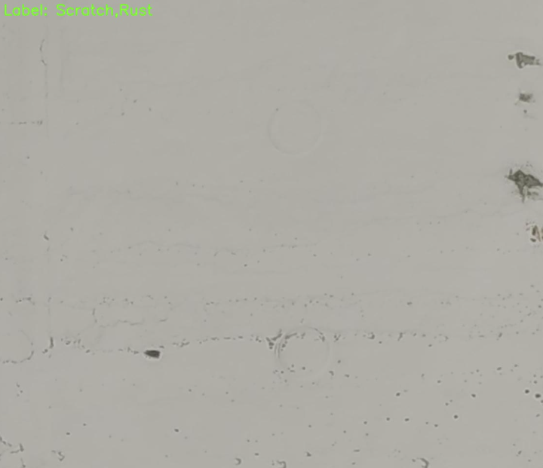
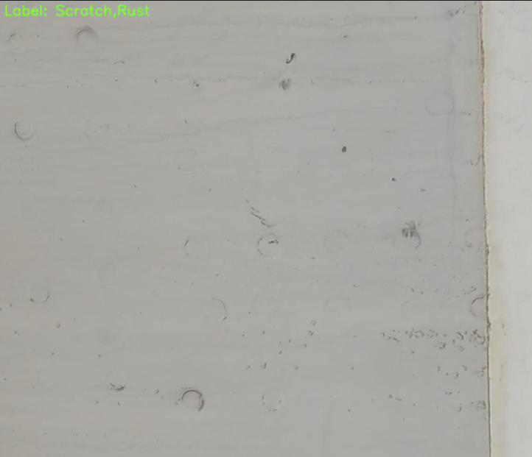

Slide 17
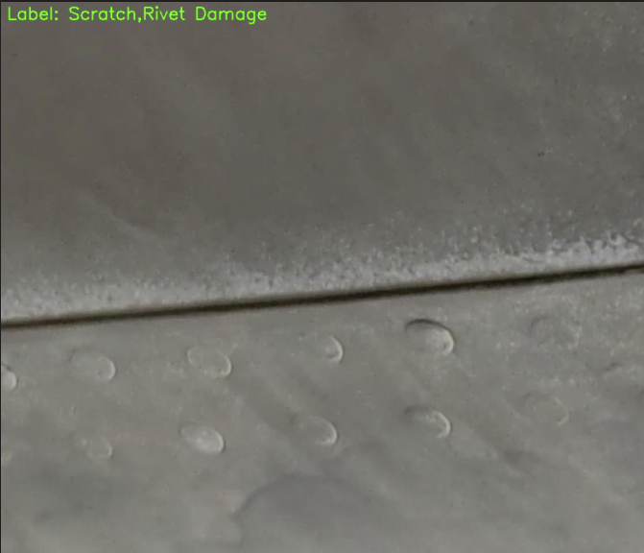
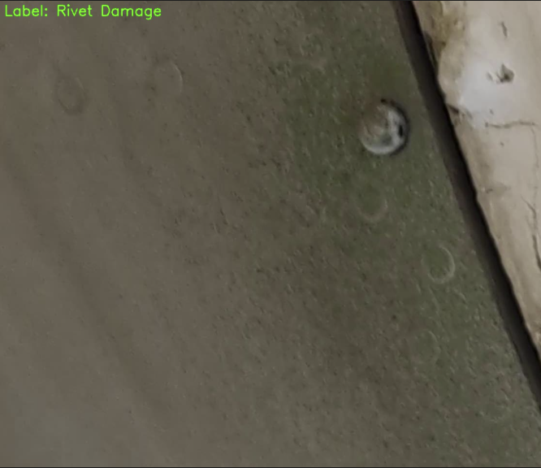
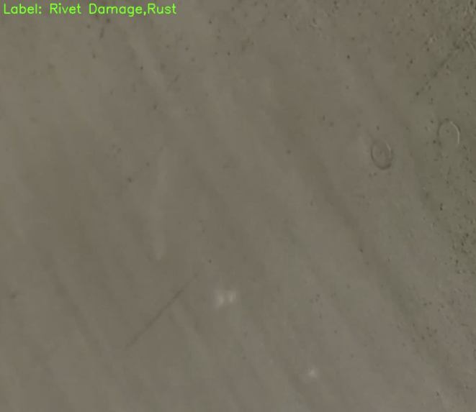
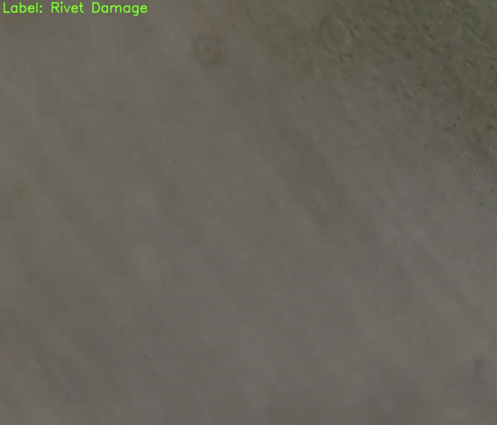
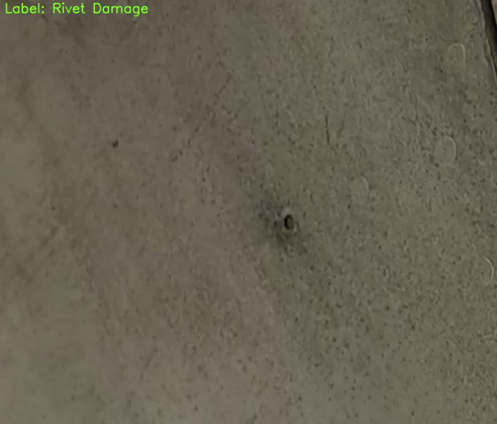
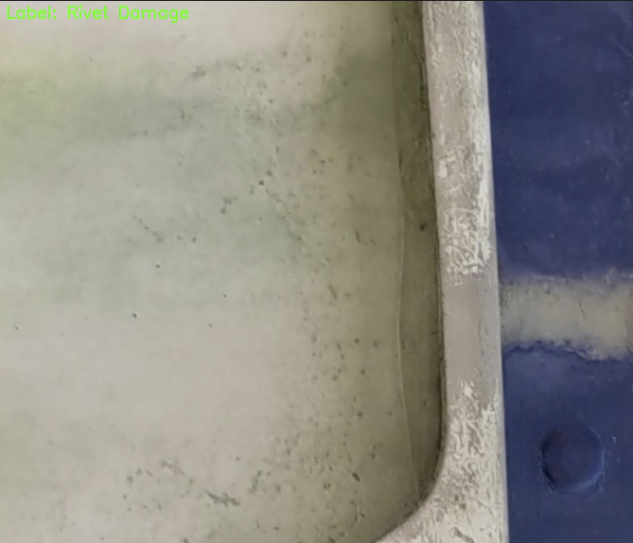

Slide 18
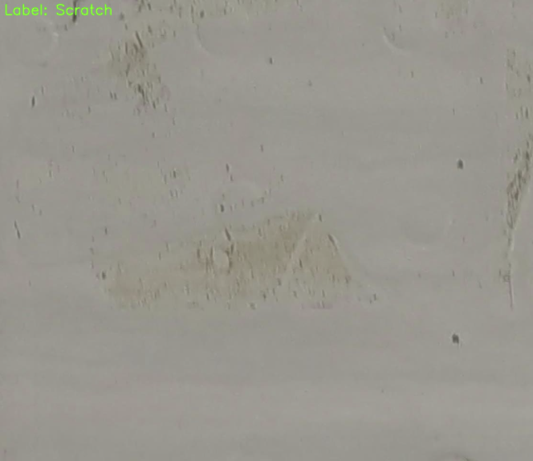






Slide 19
Challenges and Solutions
Small initial labeled set → solved with balancing and augmentation
Lack of multi-class labels → pseudo-labeling unlabeled images.
Classification of sprawling defects → solved with expanded masking.

Slide 20
Future Work
Retrain model with expanded dataset.
Improve model (larger CNNs, transfer learning).
Move to object detection models.

Slide 21
Conclusion
End-to-end defect detection pipeline created.
Dataset expanded significantly.
Strong foundation for future work.

Slide 22
Questions?

